Slide 1
MOVIE
PERFORMANCES OVER TIME
Home
Movies
Genre
Popular
Languages
Group #5’s Presentation begins here

Slide 2
BUSINESS CONTEXT
Home
Movies
Genre
Popular
Languages
The movie industry, one of the key reflections of global culture is impacted by various factors such as, technological advancements, shifting audience preferences and black swan disruptions like COVID.
Production houses face complex challenges in the dynamic landscape of the film industry. Understanding these dynamics is crucial for informed decision making.

Slide 3
ACTION PLAN…
Home
Movies
Genre
Popular
Languages
By leveraging the power of data and Tableau, we aim to contribute valuable insights on the film business.
Expansive data set from tmdb, covering a diverse range of movie attributes, allows us to delve into multifaceted research questions.
From box office performance to audience rating and genre trends, our analysis seeks to uncover patterns and trends that can inform industry stakeholders.

Slide 4
DATA DESCRIPTION
Home
Movies
Genre
Popular
Languages
Source: https://www.kaggle.com/datasets/akshaypawar7/millions-of-movies
Description:
The original data set comprises of more than 700,000 movies listed in the TMDB Dataset.
The dataset is updated till July 2023. Data points include cast, crew, plot keywords, budget, revenue, posters, release dates, languages, production companies, countries, TMDB vote counts and vote averages, reviews, recommendations.
This dataset facilitates applications ranging from analysis of historical data into patterns and trends to predicting box office revenue of a movie providing a versatile tool for researchers, analysts, and industry professionals.

Slide 5
DATA PREPARATION
Home
Movies
Genre
Popular
Languages
In the data cleaning process, the .csv format dataset, initially comprising over 700,000 movies, was refined by eliminating blank fields in key metrics such as runtime, budget, revenue, and genre.
The dataset was consequently condensed to 9,678 movies, operating under the assumption that this subset represented the total movie releases.
Calculated fields for gross profit and profit percentage were introduced.
A filter set in Tableau was implemented to distinguish between animated and conventional genres, and additional data was integrated by splitting and unpivoting the acting credits column, thereby enhancing insights, particularly focusing on the highest-grossing actors.

Slide 6
METHODOLOGIES USED
Home
Movies
Genre
Popular
Languages
We used a diverse range of charts to derive responses to our research questions, including:
Bar Charts
Line Graphs
Bubble Charts
Treemap
Pie Charts

Slide 7
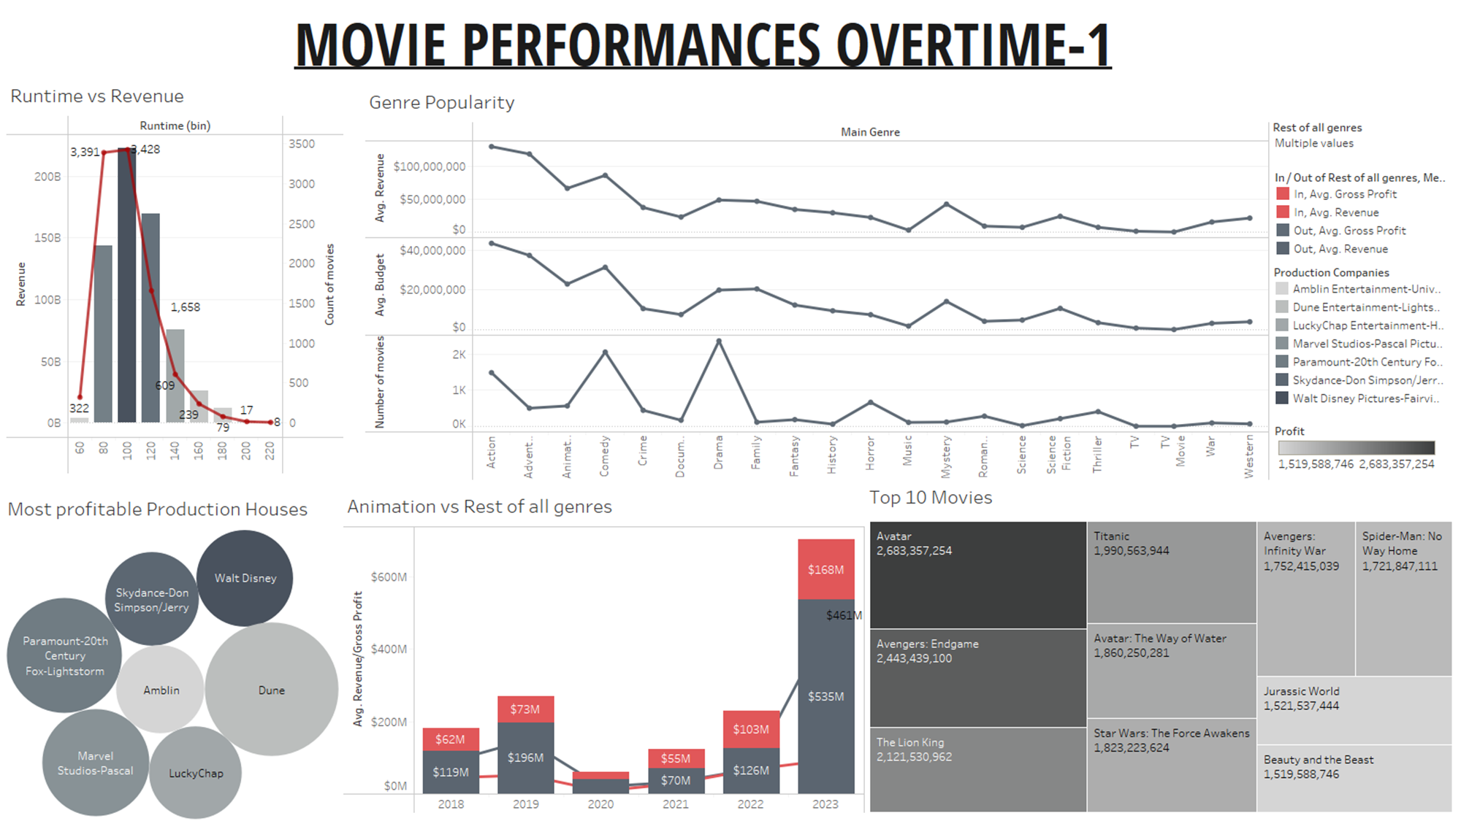
Home
Movies
Genre
Popular
Languages

Slide 8
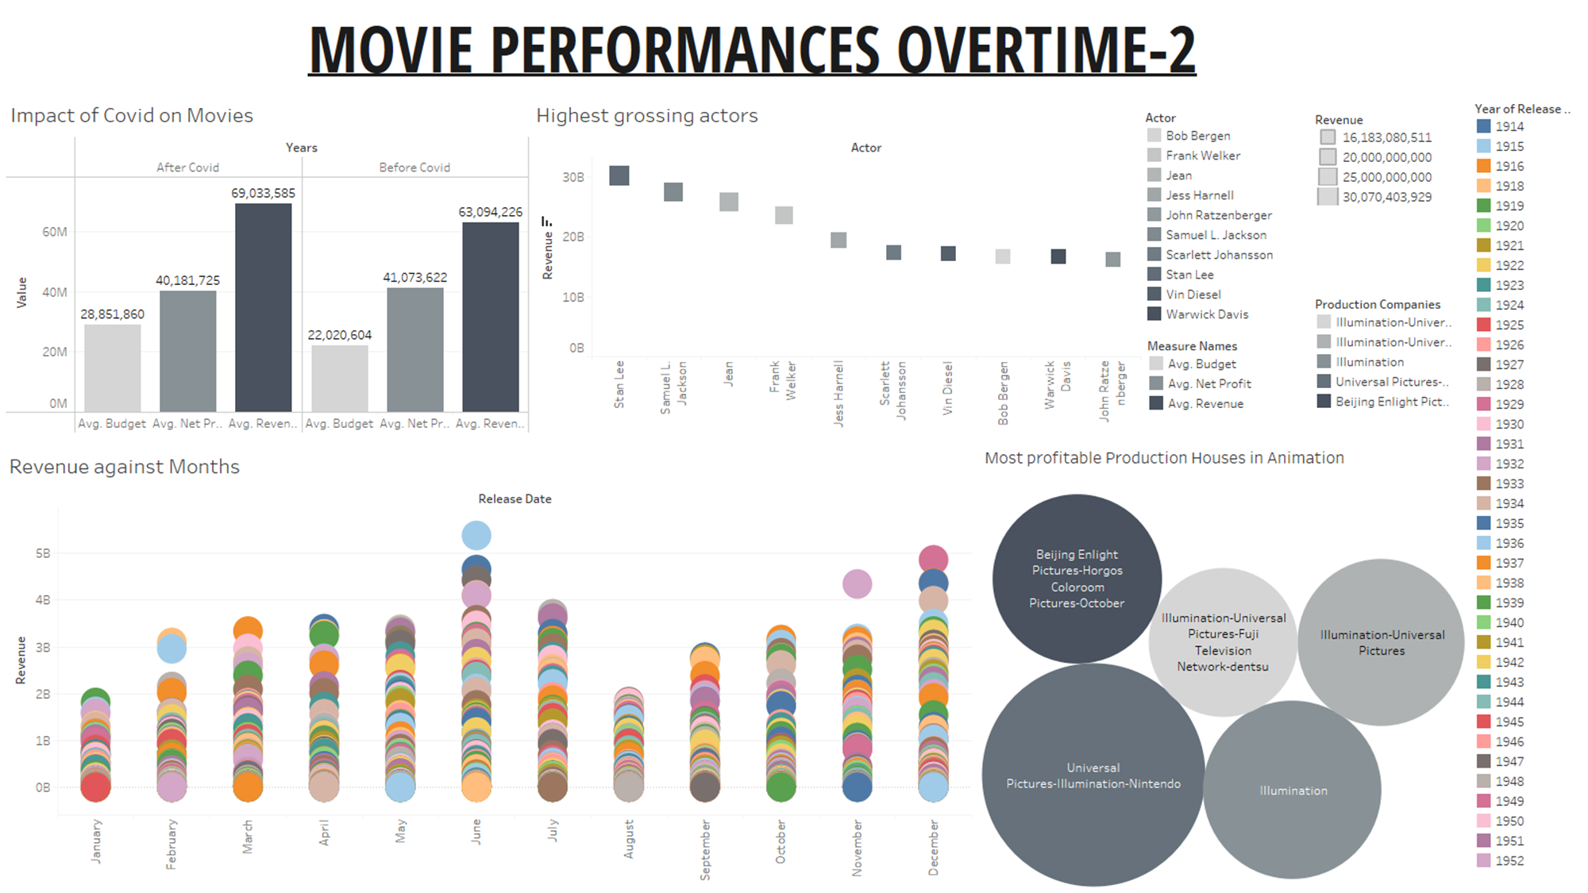
Home
Movies
Genre
Popular
Languages

Slide 9
Home
Movies
Genre
Popular
Languages
Which movies are more profitable?
01

Slide 10
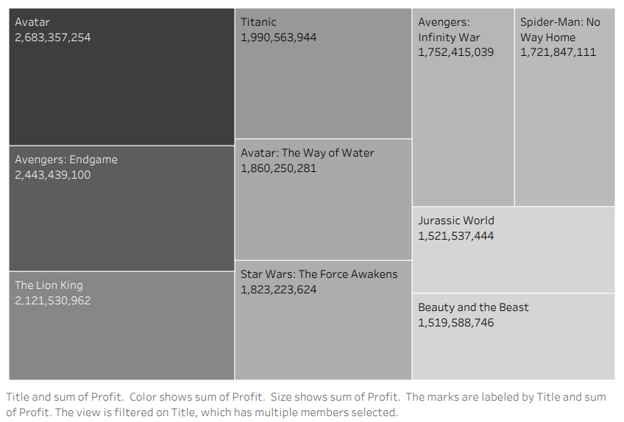
Home
Movies
Genre
Popular
Languages

Slide 11
FINDINGS
Home
Movies
Genre
Popular
Languages
James Cameron's "Avatar" stands out with an exceptional profit of $2.68 billion, showcasing the impact of compelling storytelling and groundbreaking visuals.
"Avengers: Endgame" and "Avengers: Infinity War" secure top positions, emphasizing the MCU's global appeal. Their combined profit exceeds $4 billion, showcasing the box office prowess of superhero franchises.
Disney's influence is evident with multiple entries, including "Beauty and the Beast," "The Lion King," and "Star Wars: The Force Awakens." This underscores Disney's ability to create blockbusters across diverse genres.
Despite being released years ago, "Titanic" remains among the top profitable movies. Its timeless love story and historical drama continue to attract audiences, maintaining its profitability over time.
"Jurassic World" and "Spider-Man: No Way Home" showcase efficient budget utilization, yielding profits over ten times their production costs.
The success of interconnected cinematic universes is evident. The MCU and Star Wars franchises demonstrate the effectiveness of creating expansive storytelling worlds that captivate audiences.

Slide 12
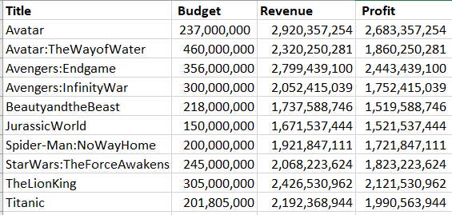
FINDINGS
Home
Movies
Genre
Popular
Languages
Franchise films like "Star Wars: The Force Awakens" and "Spider-Man: No Way Home" demonstrate the consistent success of established series in drawing audiences and generating profits.
From superhero films to fantasy epics and nostalgic animations, diverse genres populate the top 10. This suggests that success isn't confined to one genre, emphasizing the importance of captivating storytelling and audience engagement.
The movies' international success, evident in their high revenue figures, underscores the global appeal of these blockbusters, transcending cultural and geographical boundaries.

Slide 13

Home
Movies
Genre
Popular
Languages
If we think of profit purely as a ratio of production cost to box office gross, 1999’s The Blair Witch Project is the most profitable movie ever.
Budget: $200,000
Revenue: $249 million
Revenue exceeded its budget by 1244 times.
Profit % = (Revenue - Budget) *100 / Budget = 124400

Slide 14
Do movies released in certain months tend to do better?
Home
Movies
Genre
Popular
Languages
02

Slide 15
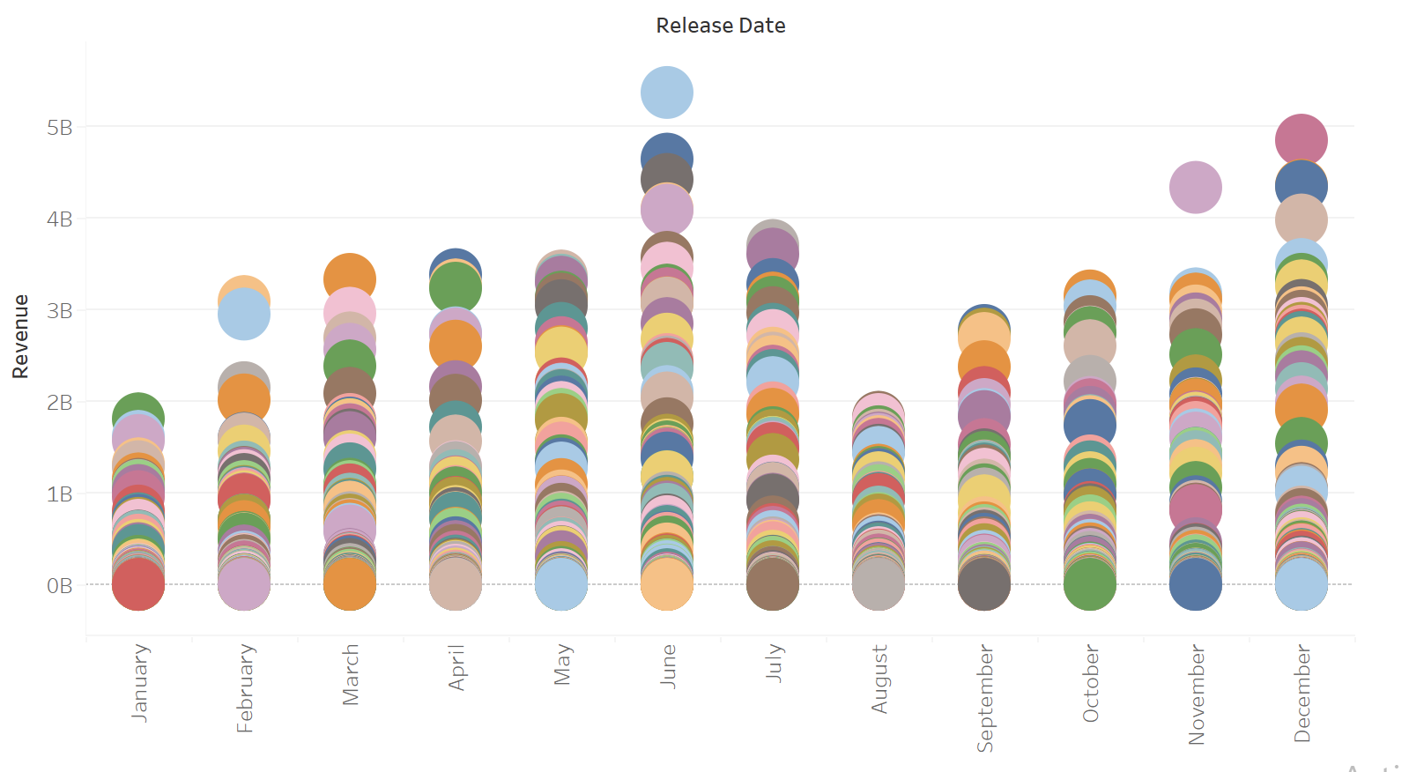
Home
Movies
Genre
Popular
Languages
Revenue vs Month

Slide 16
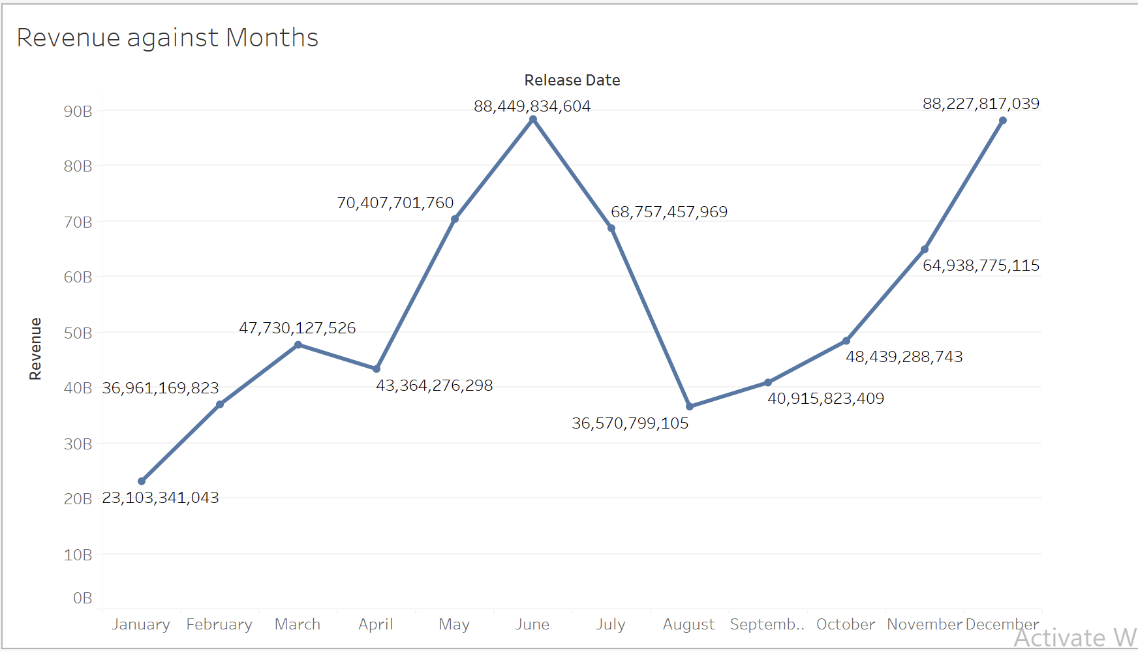
Revenue against Release Date.
Home
Movies
Genre
Popular
Languages

Slide 17
FINDINGS
Home
Movies
Genre
Popular
Languages
In the first diagram,I included all the movies ever released as pie charts to find the release month with movies that resulted in the highest revenue.
The second diagram shows the average revenue of all the movies against the various release dates to determine the trend and the resulting month with the highest revenue.
Movies that are released in the months of June and December tend to do better or movies released mid year and end of the year resulted in the highest revenue.WHY?
The reason could be because the summer months are known for the blockbuster movies which aligns well with school holidays and vacation periods making it a prime time for families to go to the movies.

Slide 18
Which is the most popular genre over the years?
Home
Movies
Genre
Popular
Languages
03

Slide 19
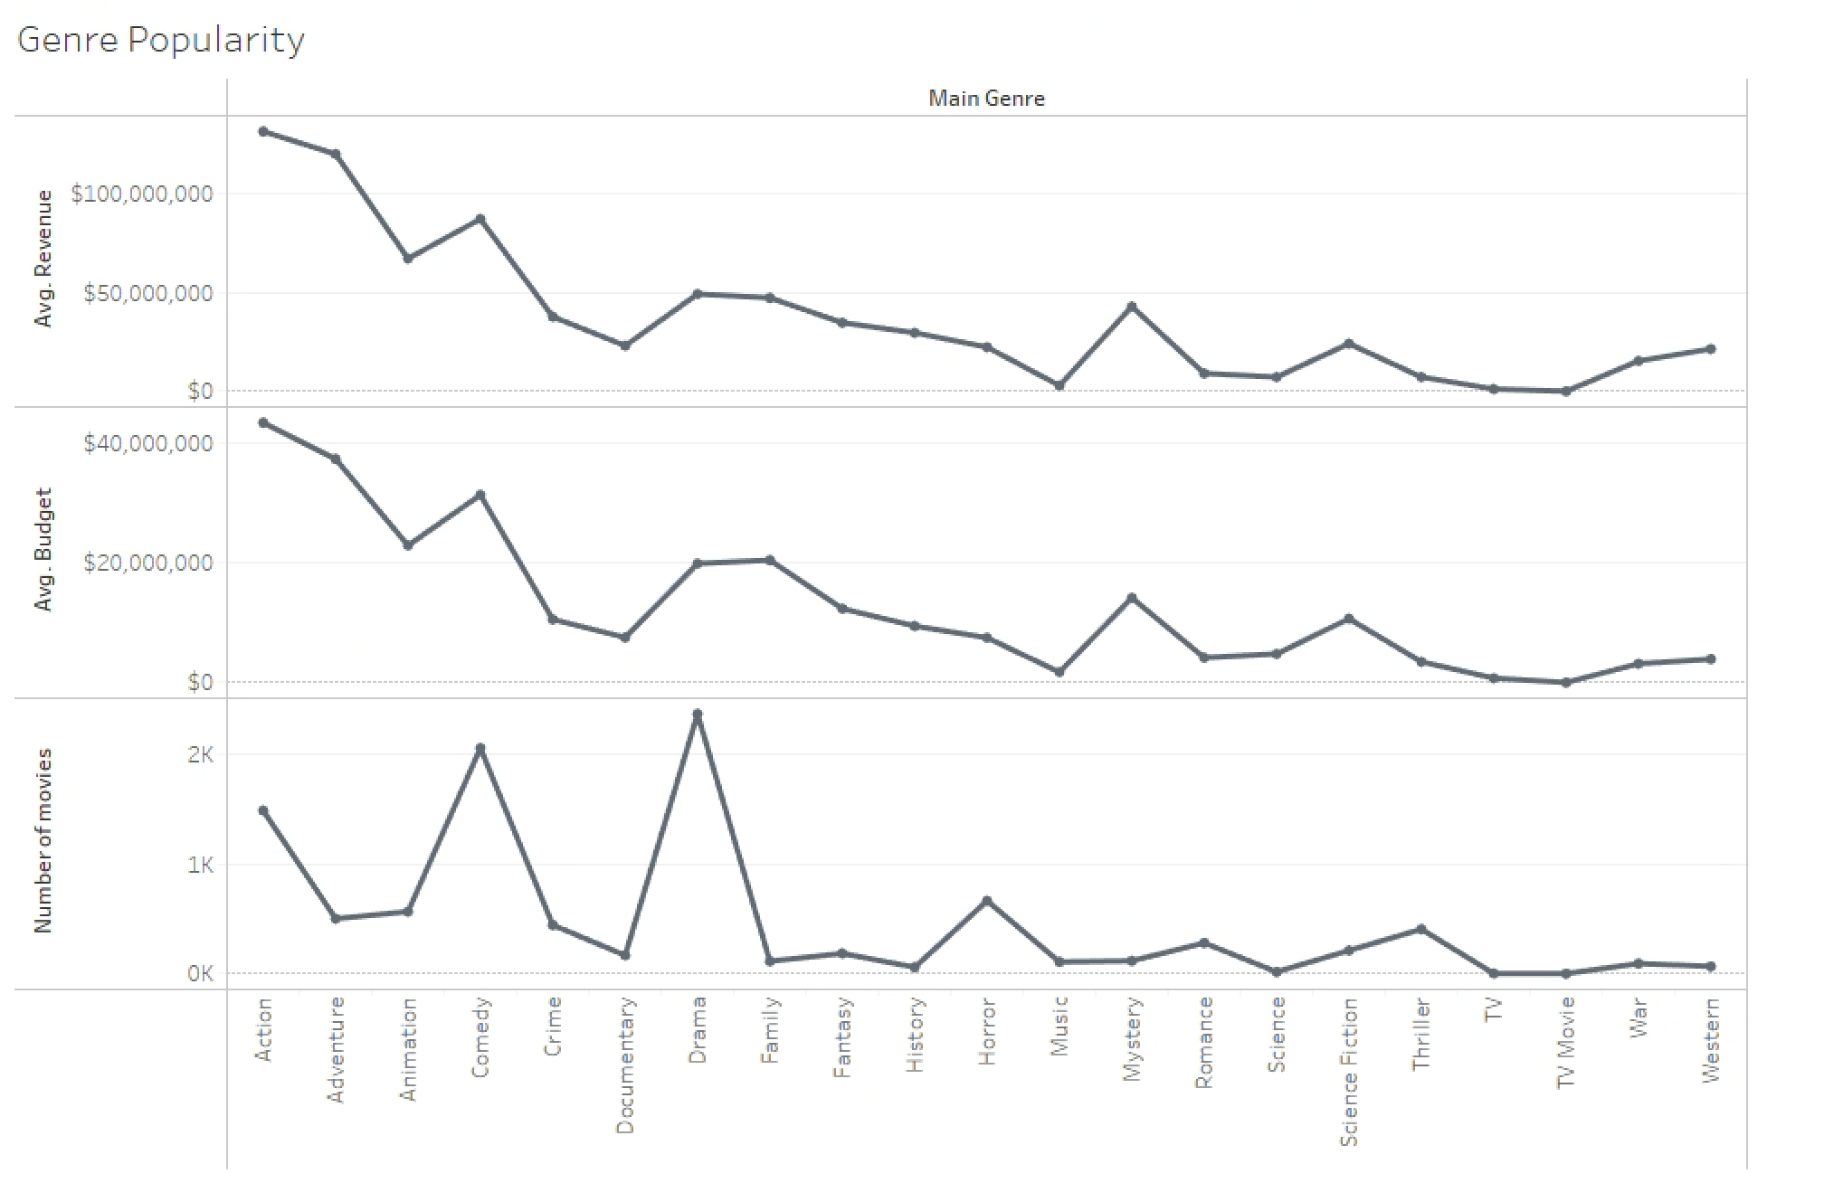
Home
Movies
Genre
Popular
Languages
Popular Genre

Slide 20

Home
Movies
Genre
Popular
Languages
Findings
To Define the popular Genre I have taken three metrics, Budget, Revenue and Number of movies made per genre.
The highest budget and revenue films belong to Action genre that can be inferred from charts 1&2.($43,481,839 Avg.Budget, $130,892,704 Avg.Revenue)
On the other hand the most number of movies made belong to Drama Genre.(2,369 movies made).
In the end the most popular genre is “Action” as the crowd pulling and revenue generation capacity to this genre is unparalleled.

Slide 21
Does runtime impact profitability of a film?
Home
Movies
Genre
Popular
Languages
04

Slide 22
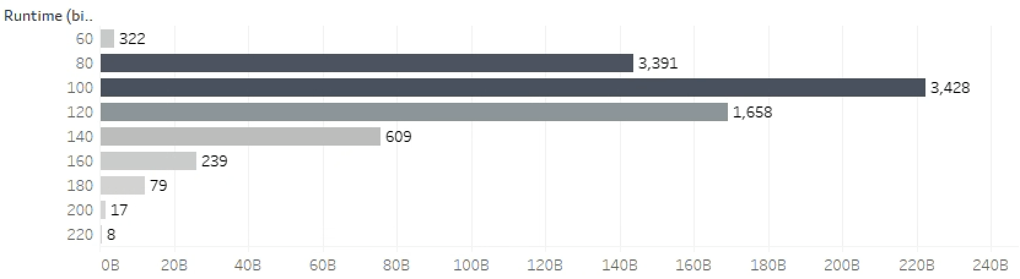
Findings
Home
Movies
Genre
Popular
Languages
Constraints
Movie length : 60-220 Minutes
Movie Budget : >$120,000
In a total of 9751 movies considered, around 87% movies fall between 80 to 120 minutes i.e., 1-2 hours. There is a significant drop in the count for longer runtimes, such as at 140. And after the 140 minutes mark, only few movies were made which contribute to less than 15% of total number of movies. Additionally, there are very few movies with runtimes of 60 and 80 minutes. Movies with runtimes of 220 and 240 minutes have significantly lower counts, indicating that longer movies are less common.

Slide 23
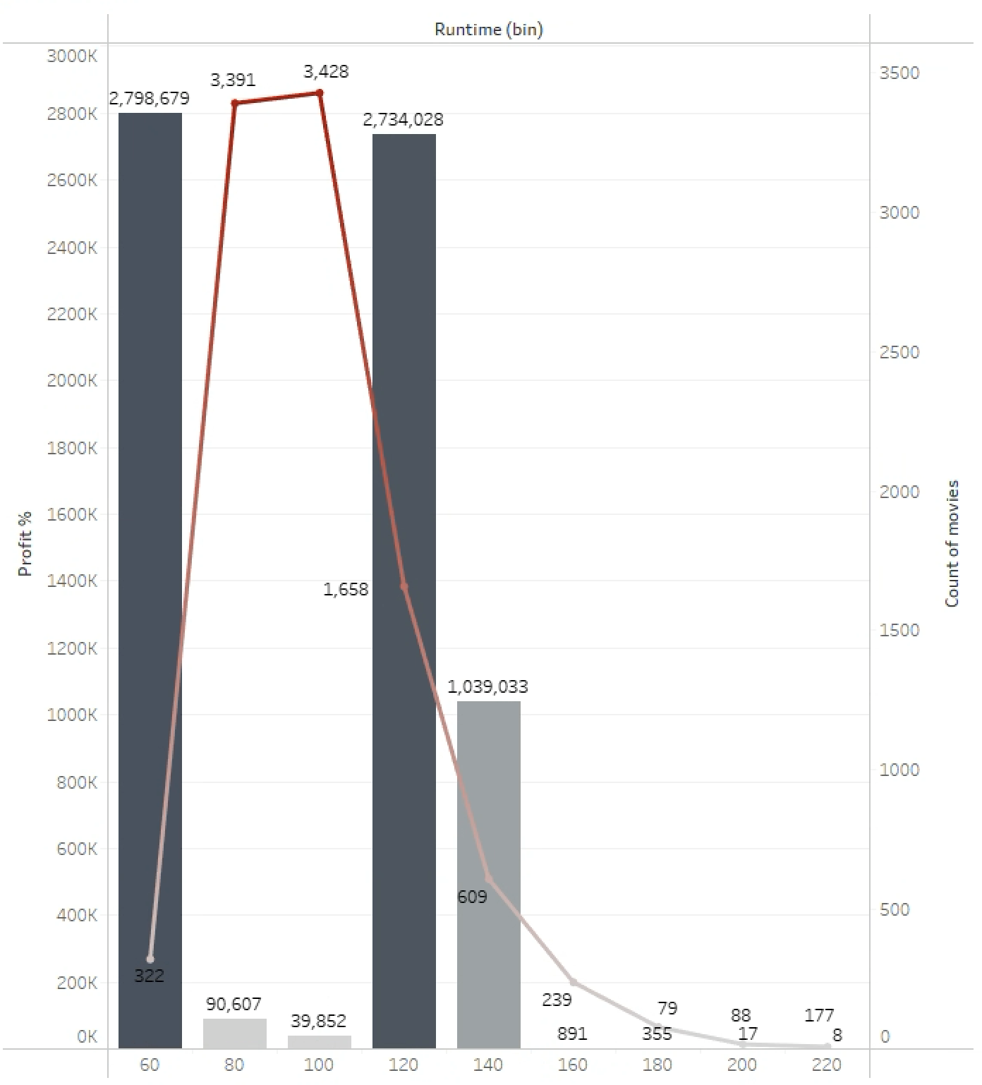
Findings
Home
Movies
Genre
Popular
Languages
In the graph shown, line represents the number of movies. The Bars represent the profit ratio calculated per each movie.
Even though the movie count peaks between 80-120 minutes, the ratio of profit is less than moderate.
The ratio of profit is highest for 60-80 minute & 120-140 minute movies.
There is a substantial difference in revenues between different runtime categories, highlighting the importance of runtime in influencing the financial success of a movie.

Slide 24
Are animated films more profitable than conventional films?
Home
Movies
Genre
Popular
Languages
05

Slide 25
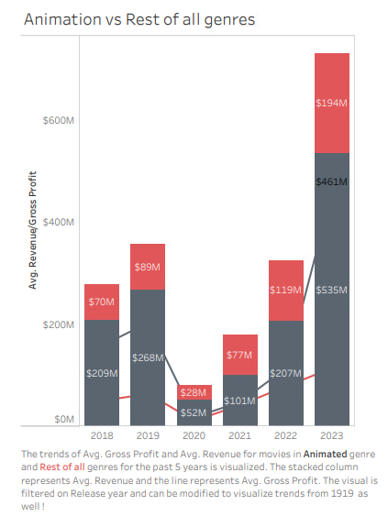
OBJECTIVE
Home
Movies
Genre
Popular
Languages
Animated films have transcended traditional boundaries, captivating audiences globally.
By delving into the revenue and profitability dynamics between the animated genre and conventional genres, we uncover key insights for industry stakeholders.

Slide 26
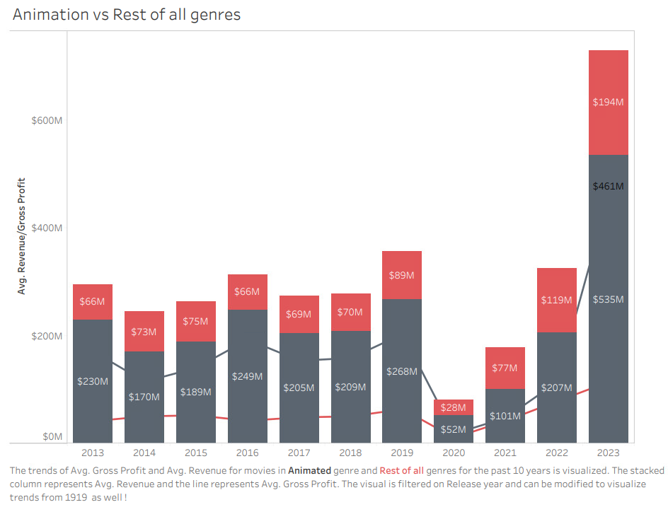
COMPARATIVE ANALYSIS - FINANCIAL METRICS
Home
Movies
Genre
Popular
Languages

Slide 27
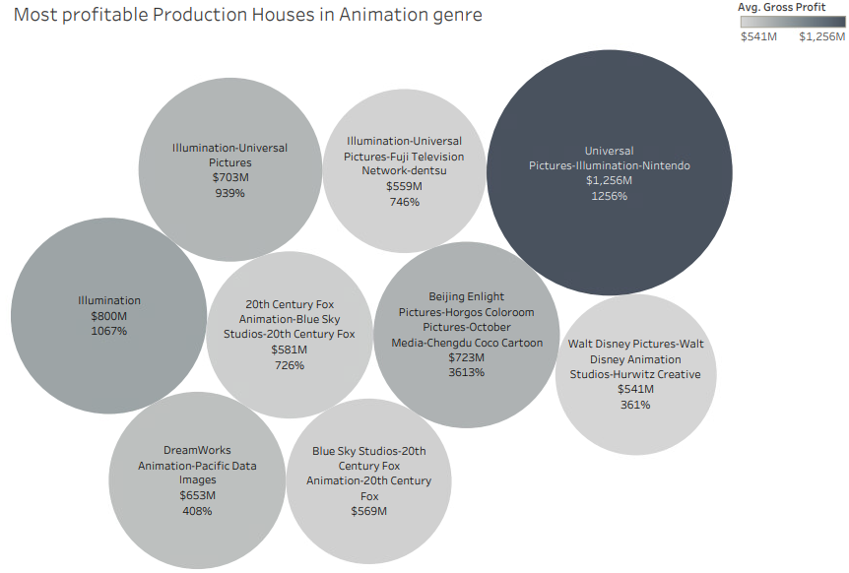
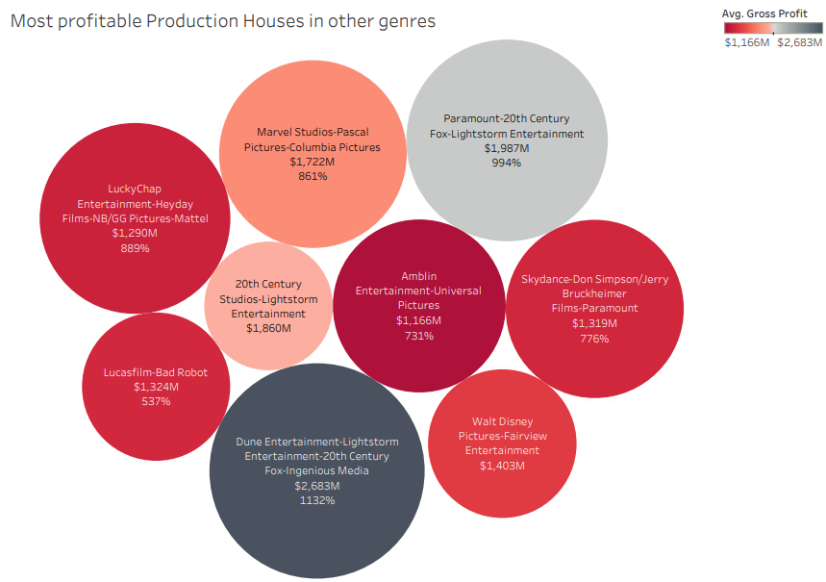
COMPARATIVE ANALYSIS - PRODUCTION COMPANIES
Home
Movies
Genre
Popular
Languages

Slide 28
Findings
Home
Movies
Genre
Popular
Languages
Animated films are expensive to film than conventional films but mint more revenue at global box office and are more profitable than conventional films.
The reason could be attributed to the Production houses involved in the making. Most profitable production houses include Universal studios in collaboration with Nintendo, a gaming/animation company, Walt Disney, a pioneer in cartoons and animation, Illumination entertainment, a professional animation studio etc.
These production houses do not figure in the most profitable production houses of conventional genres like Amblin , Marvel Studios, Lucas Films etc as they are more of a tech company into entertainment rather than a film production house.

Slide 29
Impact of Covid on Production Budgets/Revenue/Net Profit?
Home
Movies
Genre
Popular
Languages
06

Slide 30
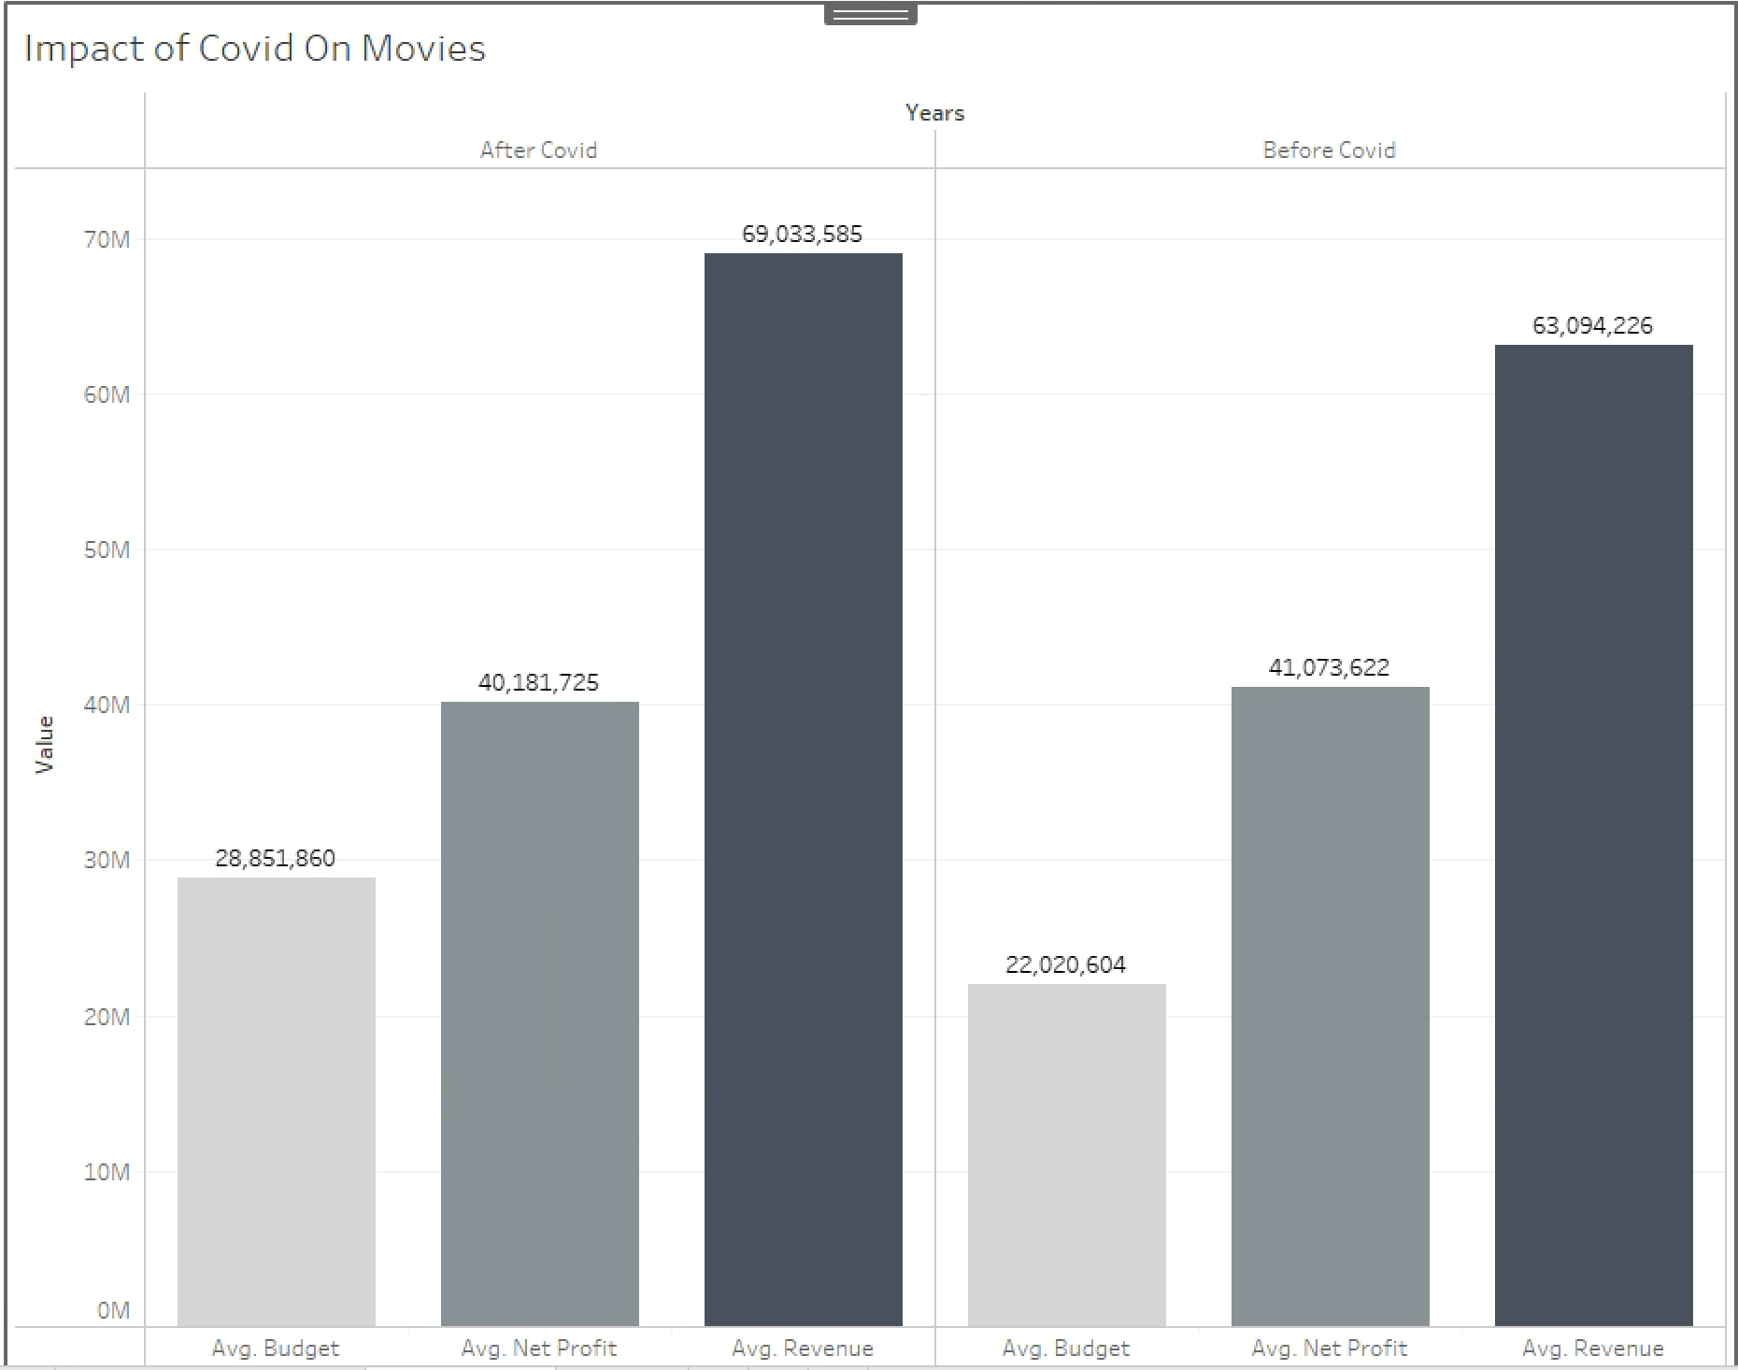
Home
Movies
Genre
Popular
Languages

Slide 31

Findings
Home
Movies
Genre
Popular
Languages
A significant increase in the average Budget post - COVID,reflecting the challenges and increased costs associated with production during the pandemic.
A relatively stable average Net Profit, showcasing the industry’s ability to navigate challenges and maintain profitability despite changes in production dynamics.
An increase in average revenue post - COVID, signaling a positive trend despite disruptions. The shift in consumer behavior and the rise of streaming services likely contributed to the growth.

Slide 32
LESSONS LEARNED
Home
Movies
Genre
Popular
Languages
The importance of data cleaning became evident, as removing blank fields, incomplete values and ensuring data integrity by eliminating unreliable data significantly improved the dashboard's reliability enabling it become a Single Source of Truth.
Making assumptions about the dataset scope, such as considering only 9,678 movies for analysis, demonstrated the need for careful consideration of assumptions and their potential impact on results.
Handling multiple genres in a film and classifying them as either animated or conventional using filter sets showcased the importance of categorization for effective analysis and understanding the functionalities present in Tableau.
These lessons learned reflect the overall process of developing a dashboard, emphasizing the importance of data quality, design, user engagement, and ongoing refinement.

